Slide 1
Dr. Niladri Choudhuri
ITIL 4 and DevOps – Way Forward for Dev and Ops

Slide 2
Agenda
DevOps – What is DevOps, Values and Principles
DevOps – 5 Ideals
State of DevOps Report 2019
DevOps – Systems Thinking and Cadence
Project to Product Approach
Why are ITIL and DevOps at Odds
ITIL 4 – New Ways of Working, Guiding Principles, 4 Dimensions, Service Value System and Practices
Role of Ops Practitioners in DevOps
Guidance for Practitioners

Slide 3

DevOps – According to Amazon
“ DevOps is the combination of cultural philosophies, practices, and tools that increases an organization’s ability to deliver applications and services at high velocity: evolving and improving products at a faster pace than organizations using traditional software development and infrastructure management processes. This speed enables organizations to better serve their customers and compete more effectively in the market.”

Slide 4
DevOps – Values
Culture
Automation
Lean
Measurement
Sharing

Slide 5
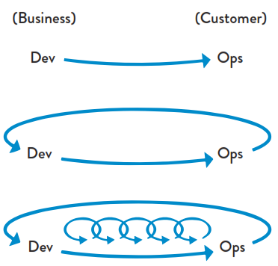
DevOps – Principles (3 Ways)
The First Way
Flow – Understand and increase the flow of work
(left to right)
The Second Way
Feedback – Create short feedback loops that enable
Continuous improvement (right to left)
Continuous Experimentation & Learning –
Create a culture that fosters:
Experimentation, taking risks and learning from
failure
Understanding that repetition and practice is the
Prerequisite to mastery
The Third Way

Slide 6
DevOps – The Unicorn Project, 5 Ideals
Locality and Simplicity
Focus, Flow and Joy
Improvement of Daily Work
Psychological Safety
Customer Focus

Slide 7
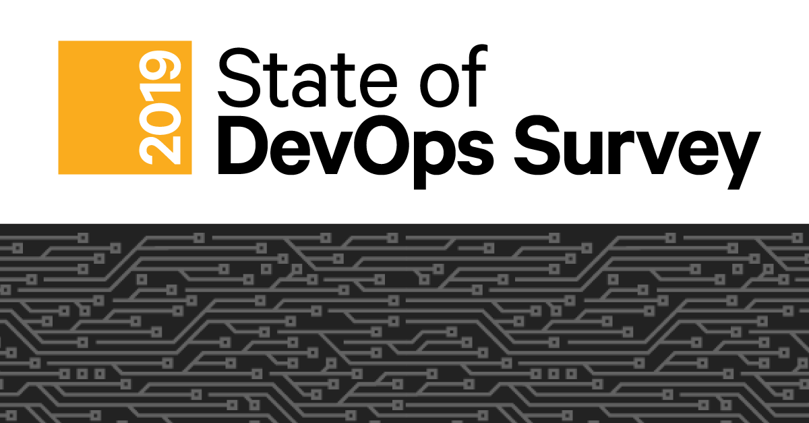
State of DevOps Report 2019

Slide 8
The State of DevOps Report 2019 – Key Highlights
The industry continues to improve, particularly among the elite performers
Delivering software quickly, reliably and safety is at the heart of technology transformation and organizational performance
The best strategies for scaling DevOps in organizations focus on structural solutions that build community
Cloud continues to be a differentiator for elite performers, and drives high performance
Productivity can drive improvements in work/life balance and reduction in burnout, and organization can make smart investment to support it
There is a right way to handle the change approval process, and it leads to improvements in speed and stability and reductions in burnouts

Slide 9
DevOps – System Thinking Throughout IT Spectrum
Understand
Desired
Outcomes
Value Stream
Identify an
Opportunity
Test
Site Reliability
Engineering
Continue
Until
Happy
Evaluate
Possible
Solutions
Code and Commit
Incident
Problem
Knowledge
SLM
Event
Deploy
And Measure
Continuous
Integration
Change
Build and Configure
Build at least
Part of it
Release
Configuration
Capacity
Availability
Continuity
Security
Stage
Release
Change
Knowledge
Event
SLM
Deploy
Continuous
Operations
Organizational agility only occurs when processes and automation are aligned.
Service
Operation
Source -DevOps Institute

Slide 10
DevOps – Cadence
The Business
Dev
Ops
$
TIME
Innovation
Waterfall Projects
Rigorous Processes
The Business
Agile/Lean DevOps
SUCCESS
Winning Through
Innovation
Continuous Delivery
Source -DevOps Institute

Slide 11
DevOps – Project vs Product Approach
Project | Product
Project Lifecycle | Product Lifecycle
Dev | Dev + Ops + Infrastructure + Security + …
One-time funded | Rolling Wave
Different Departments | Squad
Command and Control | Self-organized
Monolithic Requirements | MVP
Success – Delivery of agreed scope within agreed cost and budget | Business Value generate from Outcome
Short Term Teams | Long Term Teams

Slide 12
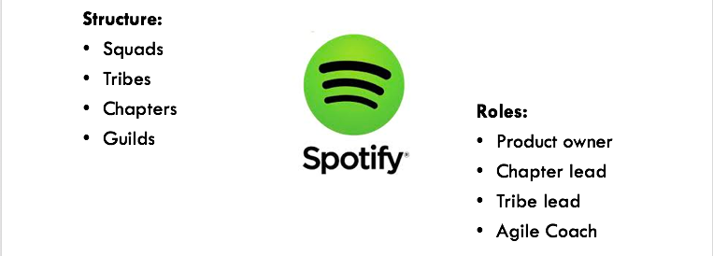
The Conway’s Law – Melvin Conway said in 1968 – Organizations which design systems are constrained to produce designs which are copies of the communication structures of these organizations.
Project Organization – Spotify Squad, Tribe, Chapter, Guild Model

Slide 13

Why are ITIL and DevOps at ODDS?
ITIL is seen by DevOps practitioners as:
“Risk averse”, “Bureaucratic”, and “anti-Agile”
Focused on processes and compliance
DevOps is seen by ITSM practitioners as:
“Brash”, “ignoring established procedure”
Focused only on developing and operating technology components

Slide 14
ITIL 4 – New ways of working in ITSM
Placing Trust in ITSM Staff
Greater Reliance on Automation
Shift Focus from Managing Technical Components to Managing Service
Managing interactions between Frameworks and Methods

Slide 15


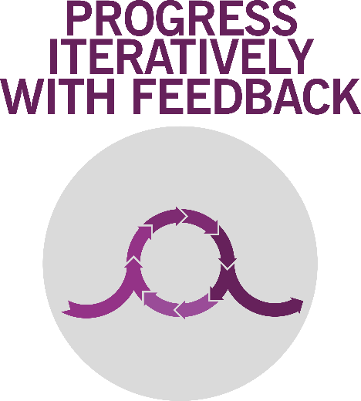
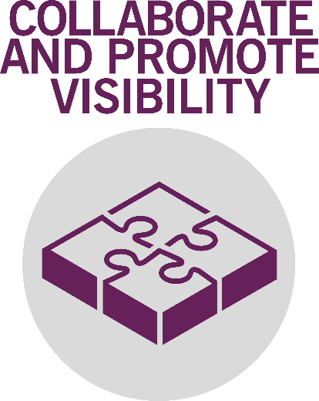

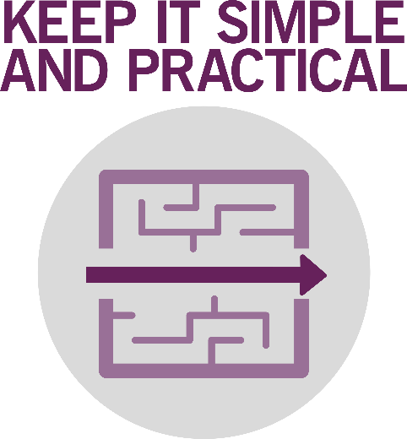
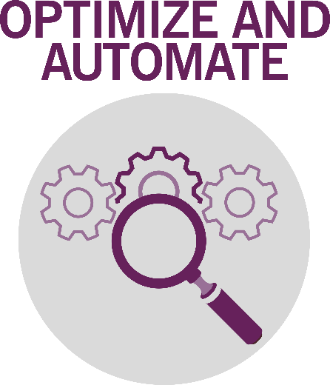
The ITIL guiding principles

Slide 16
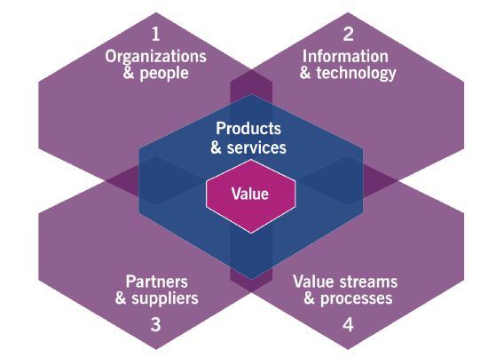
ITIL 4 - Dimensions

Slide 17
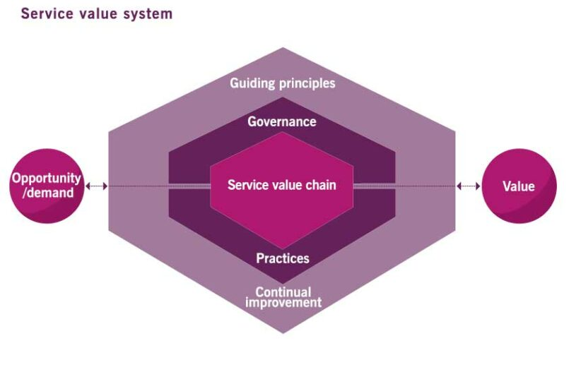
ITIL 4 – Service Value System

Slide 18
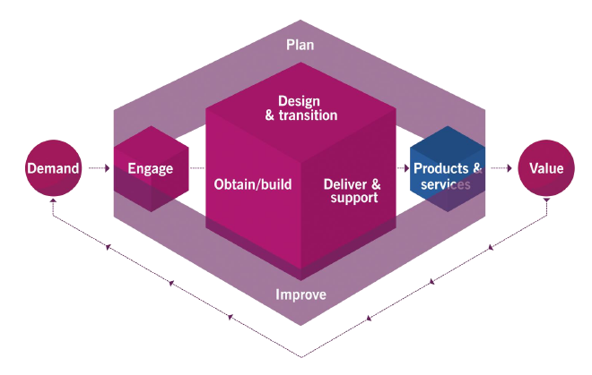
ITIL 4 – SVS

Slide 19
ITIL 4 - Practices
General Management | Service Management | Technical Management
Continual Improvement | Change Control | Deployment
Information Security | Incident and Problem | Infrastructure & Platform
Knowledge | Monitoring and Event | Software Development
Measurement & Reporting | Release
Relationship | Service Request
Workforce and Talent | Service Design
 | Service Validation & Testing

Slide 20
Role of ITSM Practitioners in DevOps
Speed MTTR
Lower Costs
Lower Maintenance Burden
Greater App Quality
15X Cheaper to fix Defects in Dev
Value Creation
Improve MTTR
Monitoring and Event Management
Infrastructure as Code
Moving to Cloud
Security

Slide 21
Guidance for ITSM Practitioners in DevOps
Change the Perspective
Change the mindset to believe that IT is an engine for innovation and business value
Be “Code” Friendly
Everything through Code. App environment changes also should be tagged, tracked and tested
IT Ops is both a Product and Service Delivery Professional
Move is from traditional Infrastructure to Platforms and “AAS”. Now IT investments are more in areas that provide business value and advantage.
Leaders need to change their way of working
No change is possible without the Leaders to support. Leaders need to know DevOps first. Then they lead as a Transformational Leader.

Slide 22
Q & A

Slide 23

Thank you very much
for your time
If you have any questions about this session,
You reach out to me through below means:
niladric@xellento.com
www.xellentro.com
Twitter- @niladrimc

